Slide 1

AI introduction
Master. Cesar Sinchiguano
Robotics and cybernetics

Slide 2
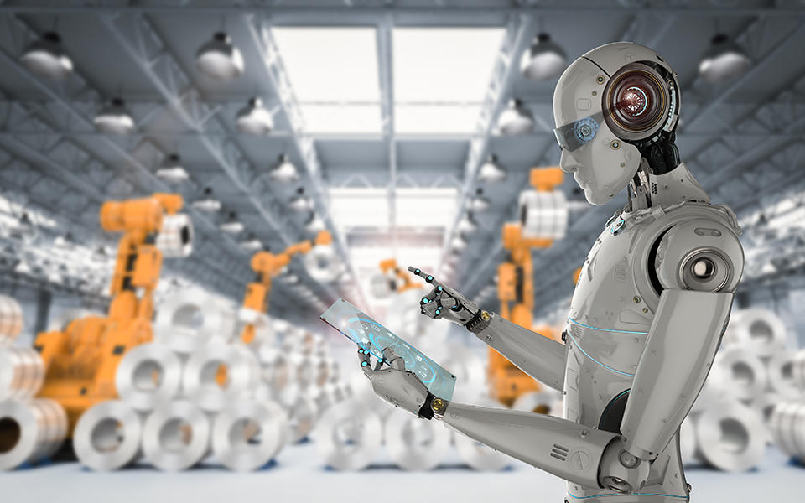
Today’s lecture
What is AI?Introduction to Artificial Intelligence LevelsHistory of Artificial IntelligenceGoals of Artificial IntelligenceSubfields of Artificial IntelligenceTypes of Artificial IntelligenceAI Vs Machine LearningWhere is AI used? ExamplesWhy is AI booming now?

Slide 3
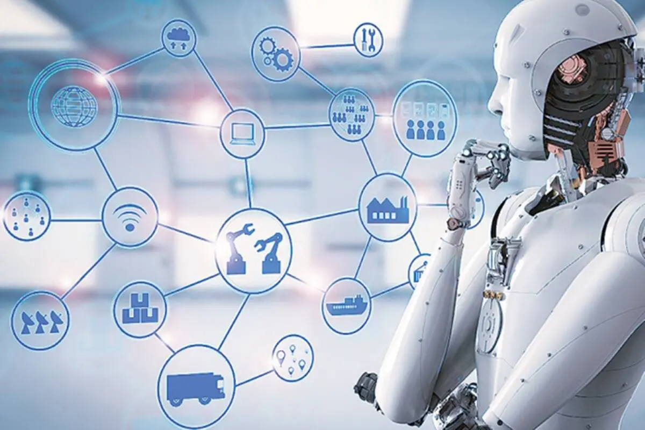
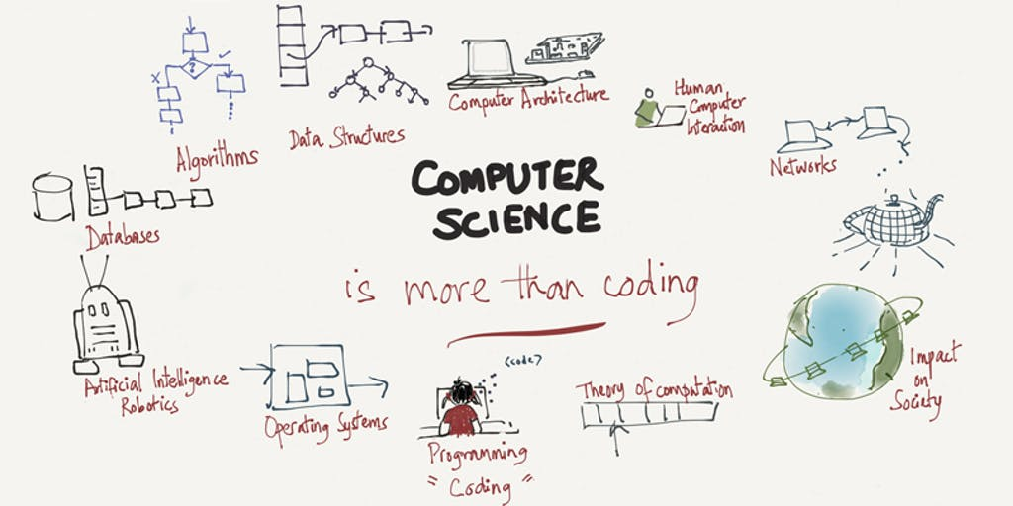
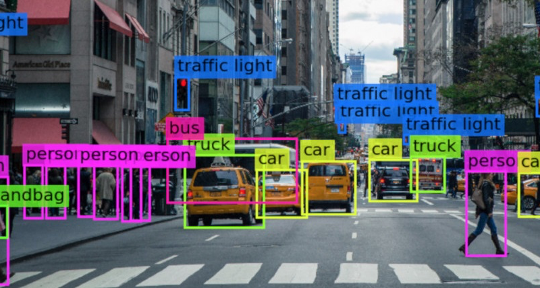
What is Artificial Intelligence (AI)?
AI is a branch of computer science that studies machine intelligence.
AI is a machine’s ability to perform cognitive functions as humans do, such as perceiving, learning, reasoning, and solving problems.
AI is defined as the ability of a digital computer or computer-controlled robot to perform tasks commonly associated with intelligent beings.
The benchmark for AI is the human level concerning in teams of reasoning, speech, and vision.
Cognitive: relating to the processes of thinking and reasoning

Slide 4
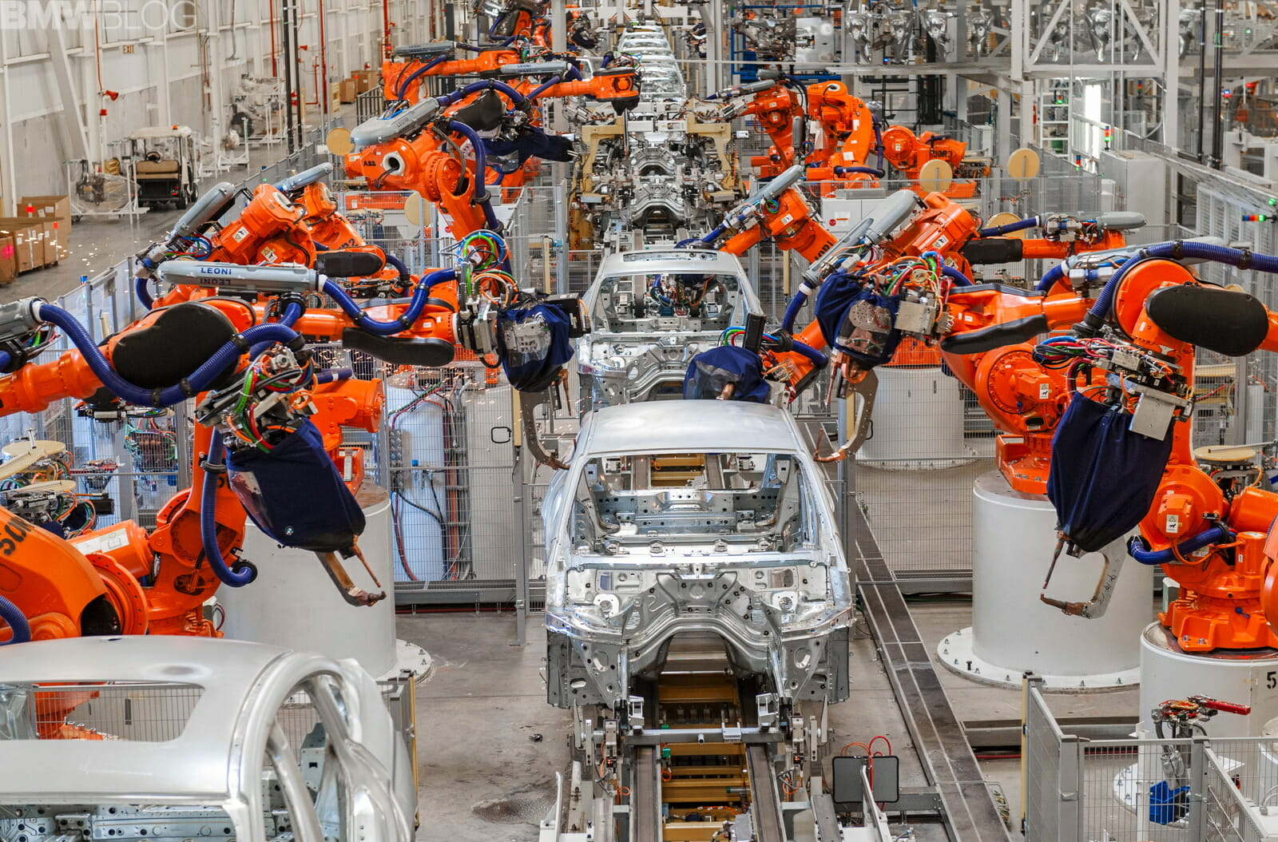
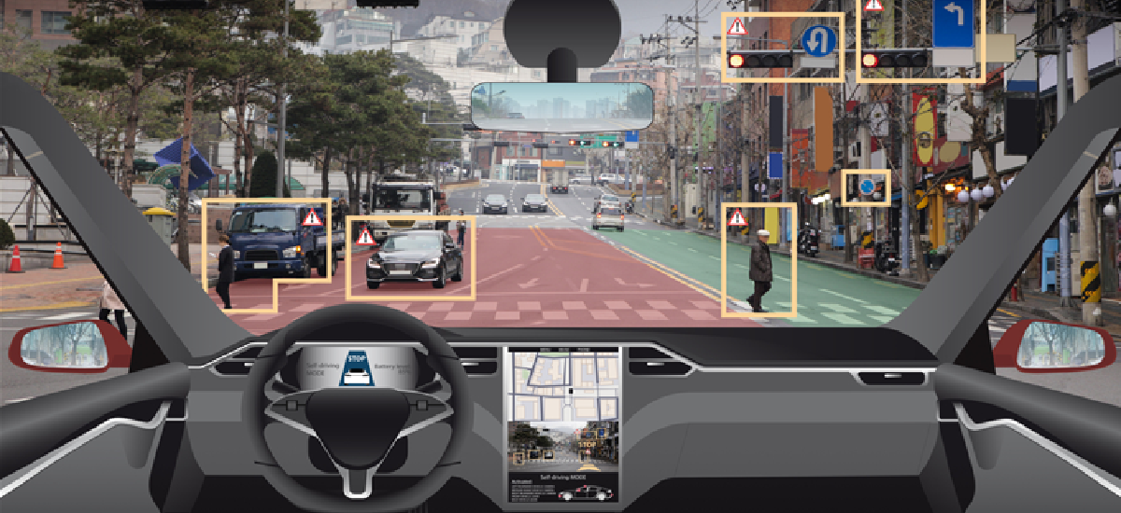
Introduction to Artificial Intelligence Levels
In a nutshell,
AI provides cutting-edge technology to deal with complex data that a human being cannot handle.
AI automates redundant jobs allowing a worker to focus on the high level, value-added tasks.
When AI is implemented at scale, it leads to cost reduction and revenue increase.

Slide 5
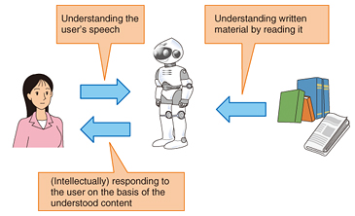
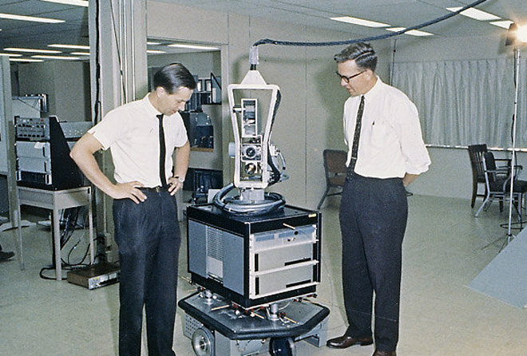
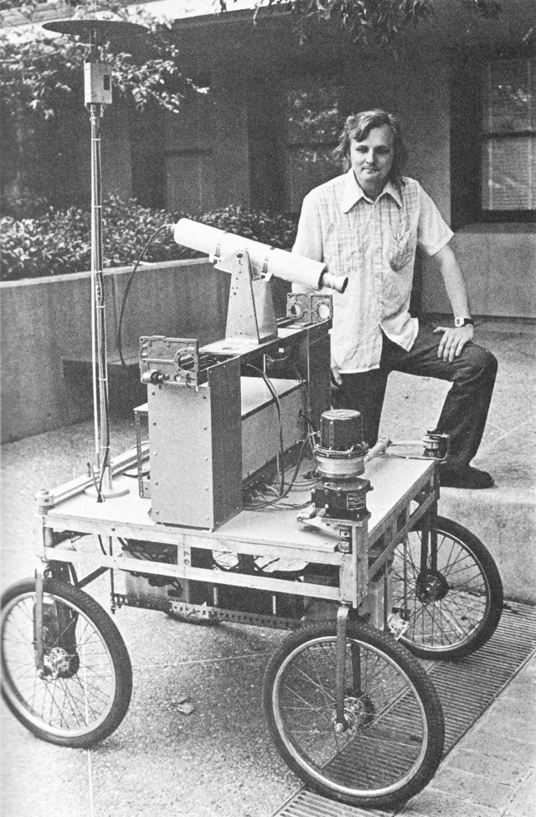
History of Artificial Intelligence
In a nutshell,
1956 John McCarthy first used the term Artificial Intelligence. Demonstration of the first running AI program at Carnegie Mellon University.
1964 Danny Bobrow’s dissertation at MIT showed how computers could understand natural language.
1969 Scientists at Stanford Research Institute Developed Shakey. A robot equipped with locomotion and problem-solving.
1979 The world’s first computer-controlled autonomous vehicle, Stanford Cart, was built.
Link 1
Link 2

Slide 6
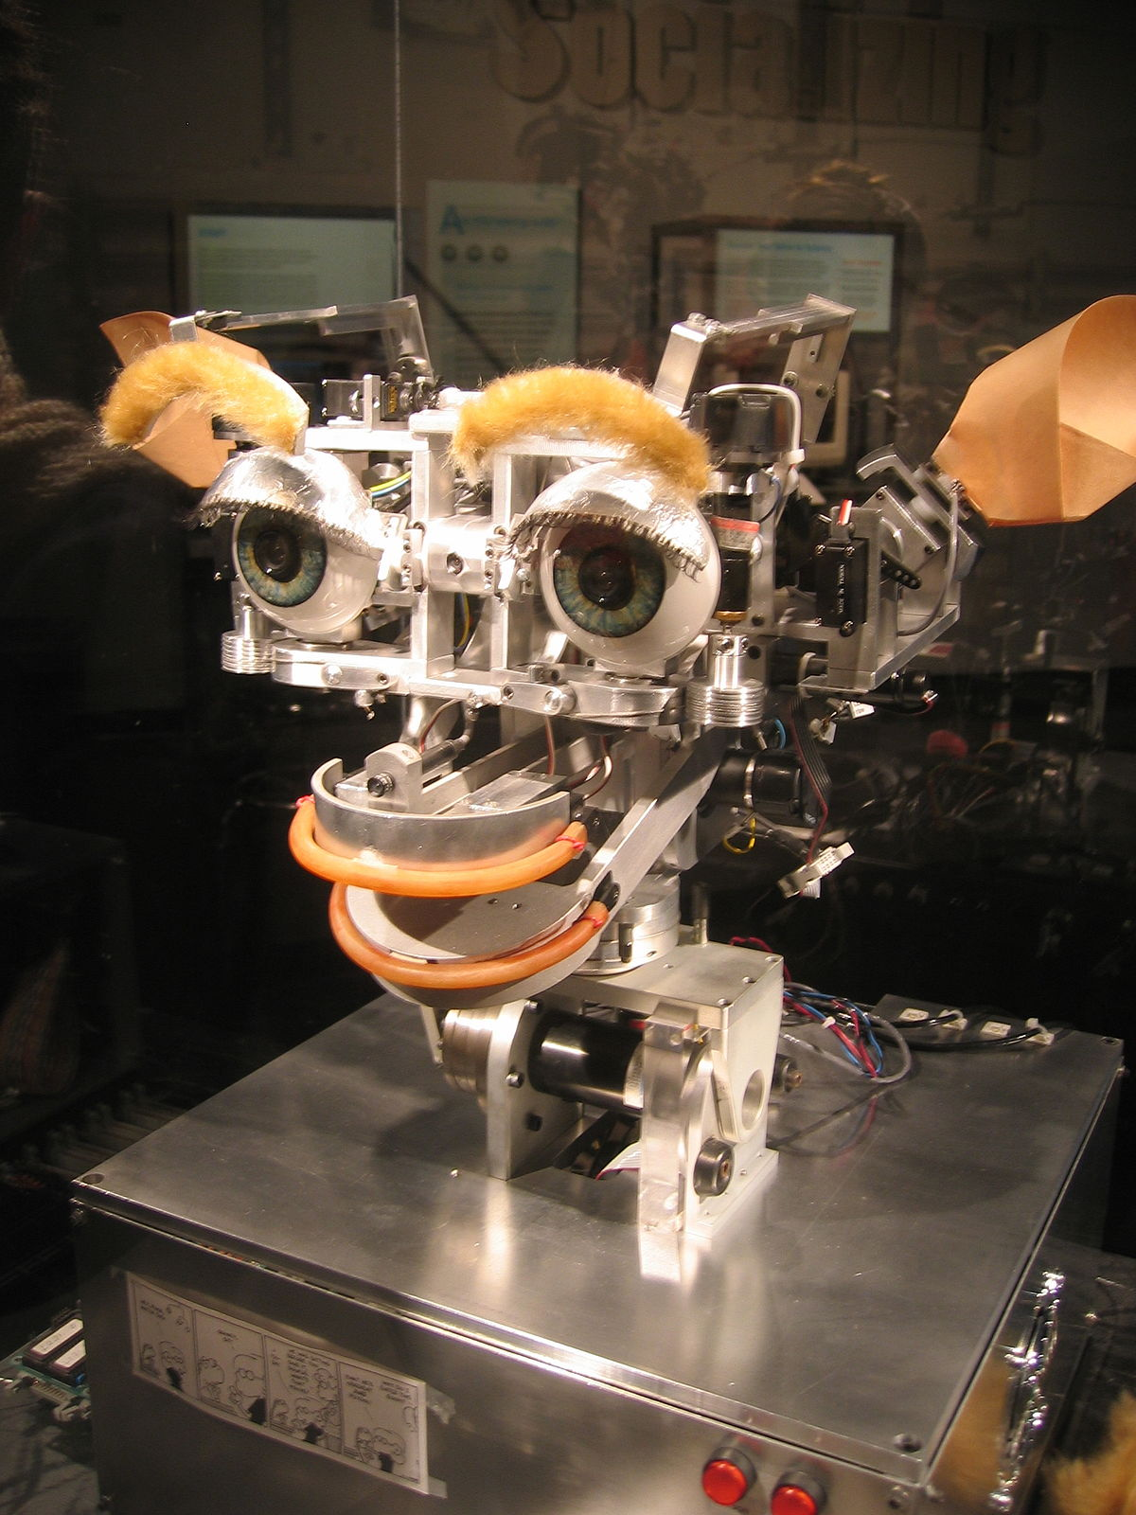
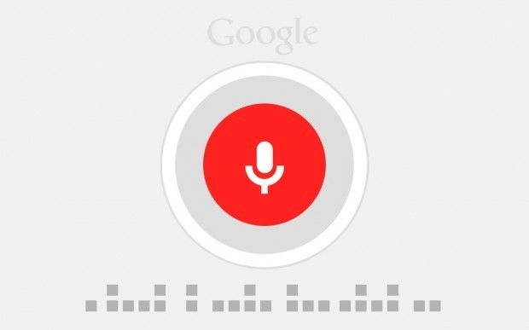

History of Artificial Intelligence
In a nutshell,
1997 The Deep Blue Chess Program beat the then world chess champion, Garry Kasparov.
2000 Interactive robot pets have become commercially available. MIT displays Kismet, a robot with a face that expresses emotions.
Link 3
2006 AI came into the Business world in the year 2006. Companies like Facebook, Netflix, Twitter started using AI.
2012 Google has launched an Android app feature called “Google now”, which provides the user with a prediction.
Link4
Cognitive: relating to the processes of thinking and reasoning

Slide 7
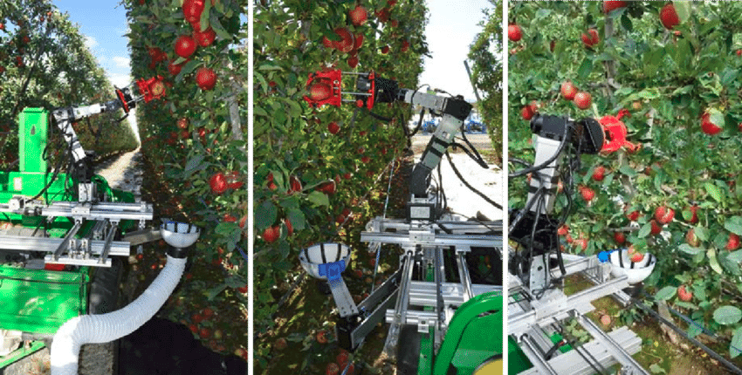

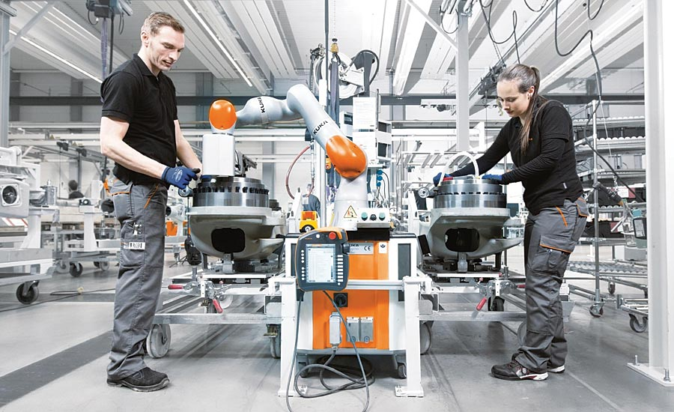
Goals of Artificial Intelligence
Here are the main Goals of AI:
It helps you reduce the amount of time needed to perform specific tasks.
Making it easier for humans to interact with machines.
Facilitating human-computer interaction in a way that is more natural and efficient.
Improving the accuracy and speed of medical diagnoses.
Helping people learn new information more quickly.
Enhancing communication between humans and machines.
Robotic Arm Picking Apples
Link5
Watson IBM
Accuracy: the fact of being exact or correct

Slide 8
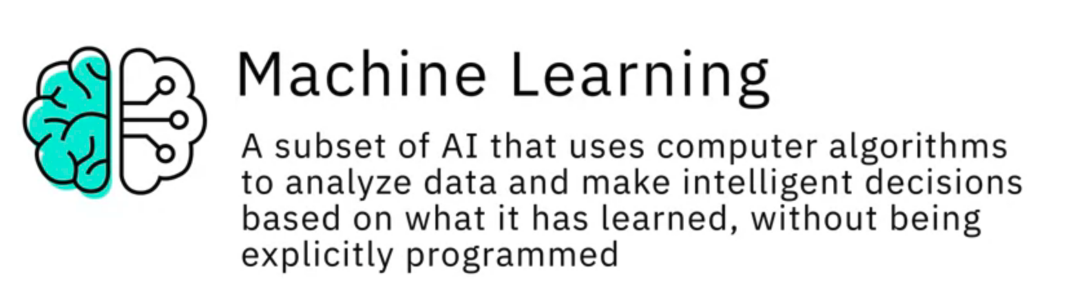
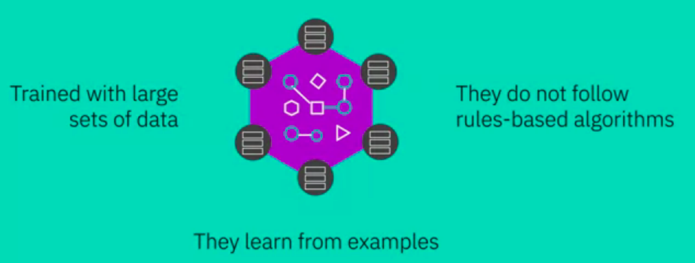
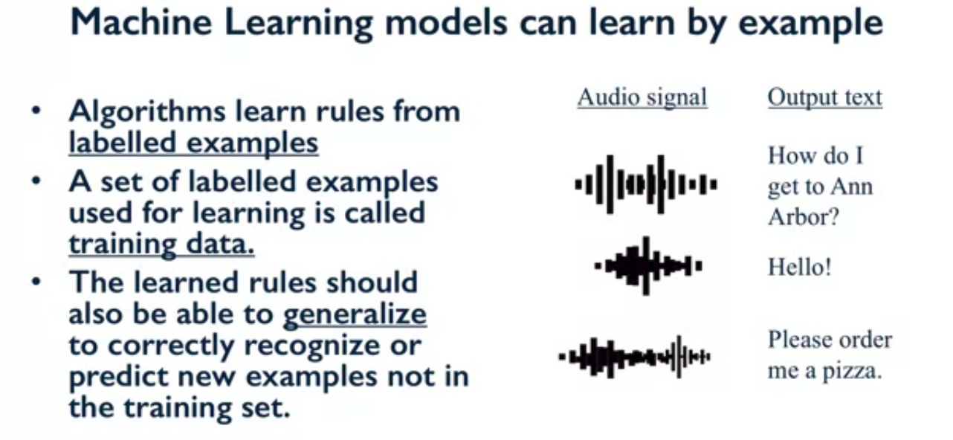
Subfields of Artificial Intelligence
Link5
Watson IBM
Accuracy: the fact of being exact or correct

Slide 9
Subfields of Artificial Intelligence
Accuracy: the fact of being exact or correct

Slide 10
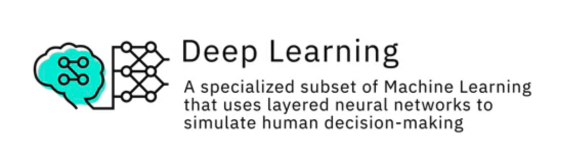
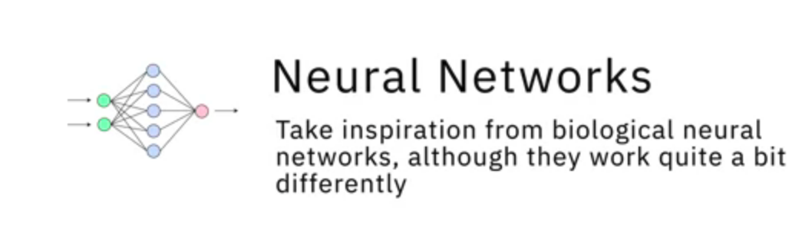
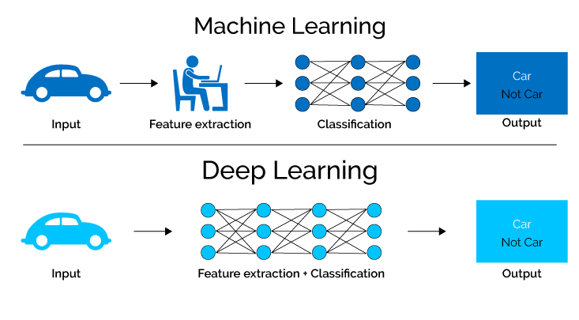

Slide 11
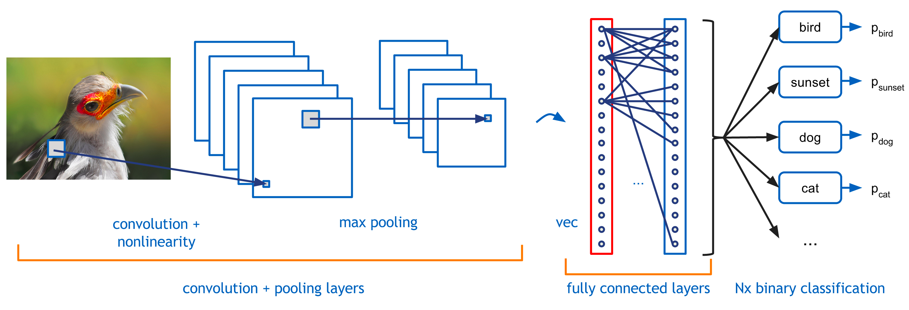
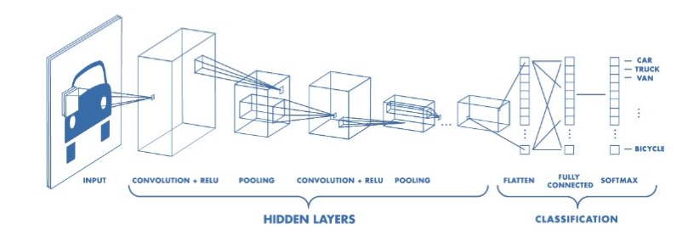
Deep Learning

Slide 12
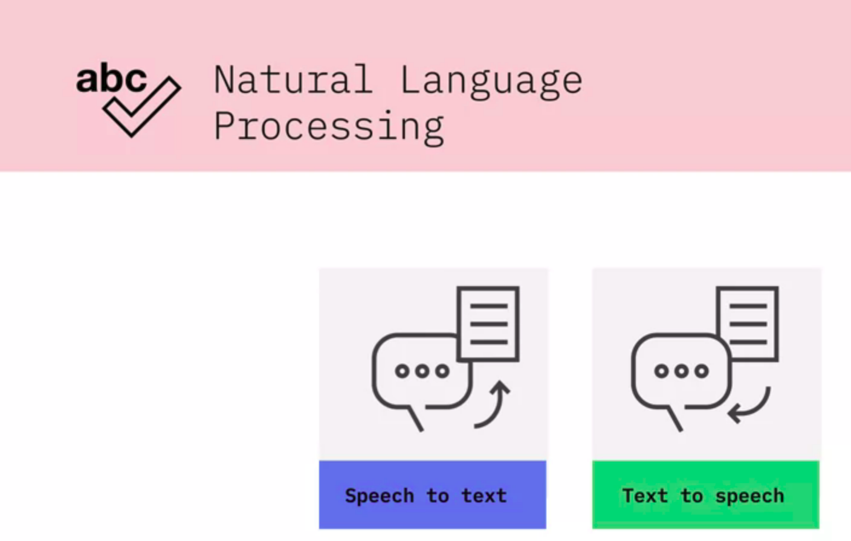
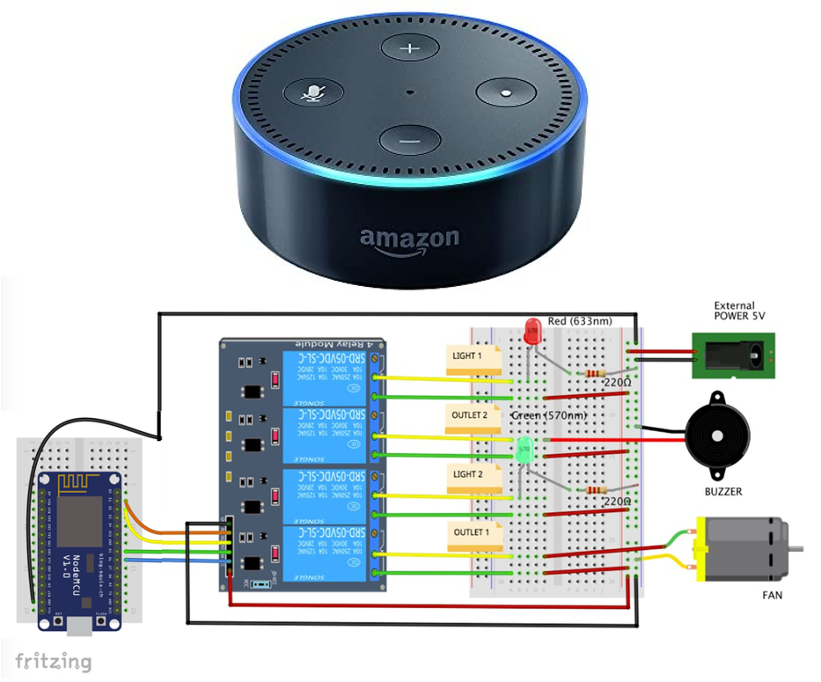
googleAssistant mine
NLP is a science of reading, understanding, and interpreting a language by a machine. Once a machine understands what the user intends to communicate, it responds accordingly.
NLP concerned with giving computers the ability to understand text and spoken words in much the same way human beings can.
NLP drives computer programs that translate text from one language to another, respond to spoken commands, and summarize large volumes of text rapidly—even in real time.
Accordingly: in a way that is suitable or right for the situation
Concerned: involved or worried

Slide 13
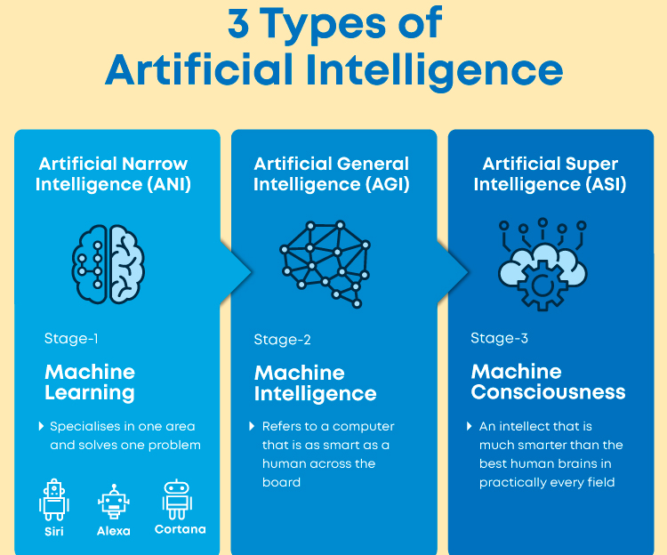
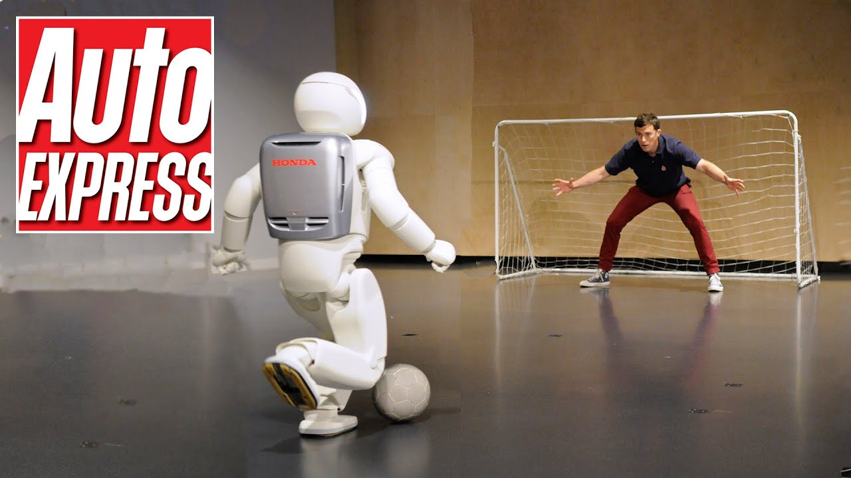
Types of Artificial Intelligence
Asimo Honda
Accordingly: in a way that is suitable or right for the situation
Concerned: involved or worried

Slide 14
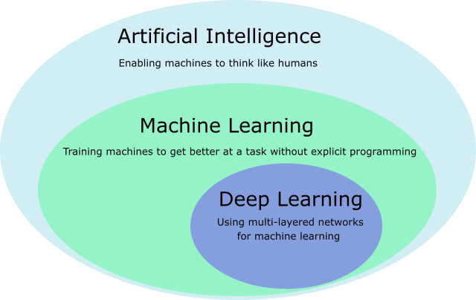
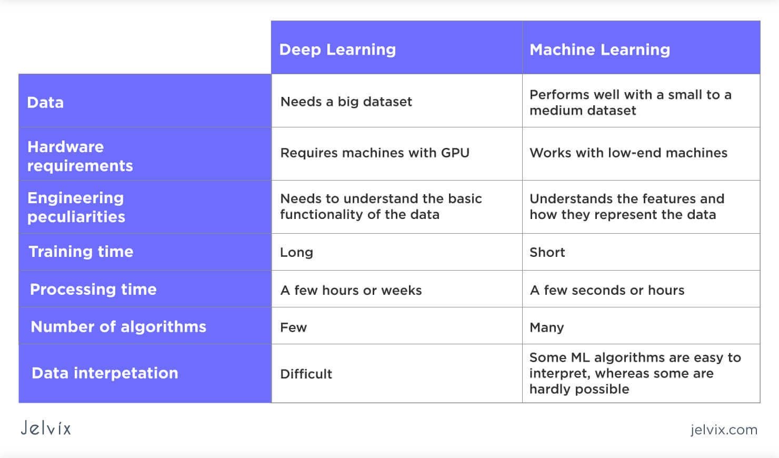
AI vs Machine Learning
Artificial intelligence is a technology using which we can create intelligent systems that can simulate human intelligence
Machine learning is a subfield of artificial intelligence, which enables machines to learn from past data or experiences without being explicitly programmed.
Accordingly: in a way that is suitable or right for the situation
Concerned: involved or worried

Slide 15
Where is AI used? Examples
Link5googleAssistant mine
Siri, Alexa, Cortana, Google Assistant and Watson
Virtual travel booking agents
Social media monitors
Automated healthcare management apps and systems
Search engines
Natural Language Processing (NLP) tools (e.g., GPT-3)
Online financial investing
Chatbots for customer support
Recommendations from Amazon, YouTube, and Netflix
Self-driving vehicles
Robotic vacuum cleaners
Manufacturing robots
Smart home devices
Accordingly: in a way that is suitable or right for the situation
Concerned: involved or worried

Slide 16
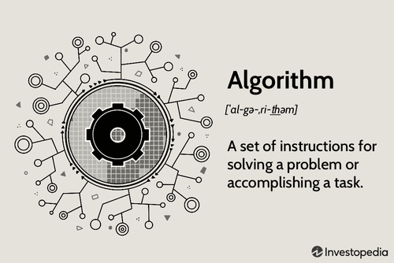

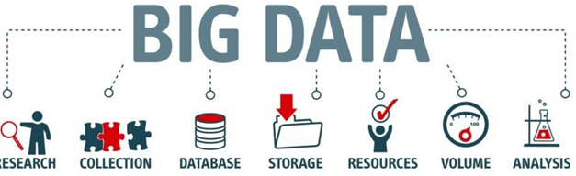
Why is AI booming now?
Hardware is more powerful than ever, data is easily accessible, but one thing that makes the neural network more reliable is the development of more accurate algorithms.
Hardware
Data
Algorithm
For instance, with an NVIDIA TITAN X, it takes two days to train a model called ImageNet against weeks for a traditional CPU.
Data powers artificial intelligence. Without data, nothing can be done. The latest Technologies have pushed the boundaries of data storage, and it is easier than ever to store a high amount of data in a data center.
Artificial intelligence combined with data is the new gold
Accordingly: in a way that is suitable or right for the situation
Concerned: involved or worried

Slide 17
Summary
AI is a full form of Artificial intelligence is the science of training machines to imitate or reproduce human tasks.
A scientist can use different methods to train a machine. At the beginning of the AI’s ages, programmers wrote hard-coded programs, typing every logical possibility the machine could face and how to respond.
When a system grows complex, it becomes difficult to manage the rules. To overcome this issue, the machine can use data to learn how to take care of all the situations from a given environment.
The most important feature of having a powerful AI is that it has enough data with considerable heterogeneity. For example, a machine can learn different languages as long as it has enough words to learn from.
AI is the new cutting-edge technology. Ventures capitalists invest billions of dollars in startups or AI projects, and McKinsey estimates AI can boost every industry by at least a double-digit growth rate.
General AI, Rule-based AI, Decision tree AI, Super AI are types of artificial intelligence.

Slide 18
Gracias

Slide 19
To learn more about Machine Learning, Deep Learning, and Neural Networks, read these articles:
Models for Machine Learning
Applications of Deep Learning
A Neural Networks deep dive
[Optional]
Hands-on Lab - Gesture Detection
Hands-on Lab - Gesture Detection
Hands-on Lab - Gesture Detection
What Is AI or Artificial Intelligence?

